Slide 1

AI Well-Being Companion
Mental Wellness and Fitness Coach
Generative AI Training
Hackathon Project

Slide 2
About Project
This project is a web-based AI companion designed to support both mental wellness and physical fitness.
Users can share their mood, stress level, or daily feelings, and the system responds with supportive messages, mindfulness tips, and simple coping strategies.
At the same time, the AI generates personalized workout and activity plans based on the user’s age, goals, and daily routine.
The entire system focuses on non-medical, safe, wellness-oriented guidance, presented in a clean and easy-to-use web interface.

Slide 3
Team Members & Work Division
Muhammad Junaid Nazar (Team Lead): Web development (React + Vite), Backend (FastAPI integration), deployment-ready setup, slides, and final hackathon presentation.
Ms. Noor Fatima Mir: Mental wellness mood mapping, supportive messages, prompt engineering.
Ms. Zainab: Mindfulness & stress relief techniques (breathing, grounding, relaxation flows).
Ms. Zunaira Sajjad: Journaling prompts and mental health tips for each mood.
Dr. Ammar Masood: Fitness plans & workout routines (weight loss, muscle, general fitness, flexibility)

Slide 4
Problem Statement
Stress, burnout, lifestyle imbalance
Mental wellness needs support
Fitness plans often confusing or unsafe
Need for simple, safe, non-medical AI companion

Slide 5
Goals & Scope
Mood-based emotional support
Non-medical mindfulness tips
Personalized fitness plans
AI chatbox for general queries
Health-report upload for analysis

Slide 6
System Architecture
React Vite frontend (UI)
FastAPI backend (processing + AI)
Fitness plan generator
Mood wellness engine
AI Chatbox (LLM-based)
File upload + report analysis
CORS + API communication

Slide 7
Features
Mental Wellness
Fitness Coach
AI Chatbox
Report Upload AI Analyzer
Team Page
Footer + responsive UI

Slide 8
Mental Wellness Workflow
User selects mood
User writes feelings
Backend processes
Returns emotional support + mindfulness + journaling prompt

Slide 9
Fitness Coach Workflow
Select Goal
Activity Level
Age Group
Algorithm generates personalized plan

Slide 10
AI Chatbox & Upload
Ask anything → AI replies
Upload health report (.docx, .pdf) → summarization + advice
Non-medical guidance only

Slide 11
Tech Stack
Frontend: React + Vite, Tailwind, Fetch AP
Backend: FastAPI, Python, Uvicor
AI: Open-source LLM APIs (e.g., HuggingFace free endpoint
Editor: VS Code
Deployment:
Vercel (Frontend)
Render (Backend)

Slide 12
Challenges
CORS issues
Backend communication errors
Environment variable setup
Deployment conflicts
Large AI models → slow responses
Report parsing reliability

Slide 13
Achievements
Fully working multi-feature AI web app
Team collaboration
Clean UI + responsive design
Realistic non-medical AI support
Report parsing system
Successfully deployed frontend + backend

Slide 14
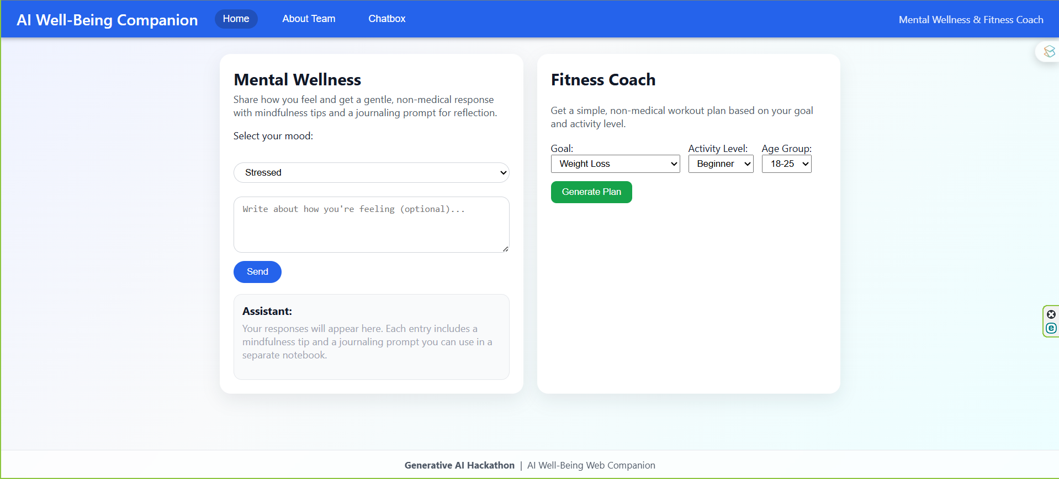
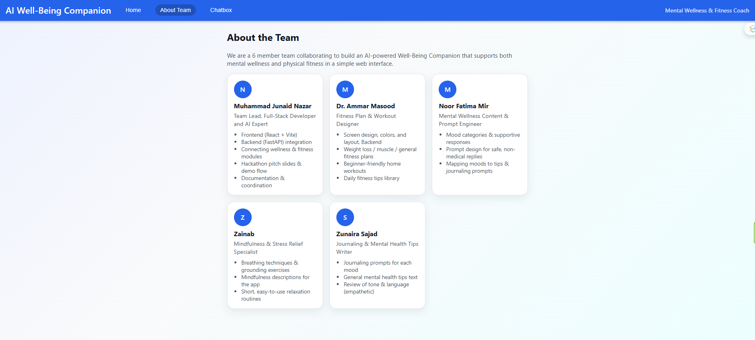
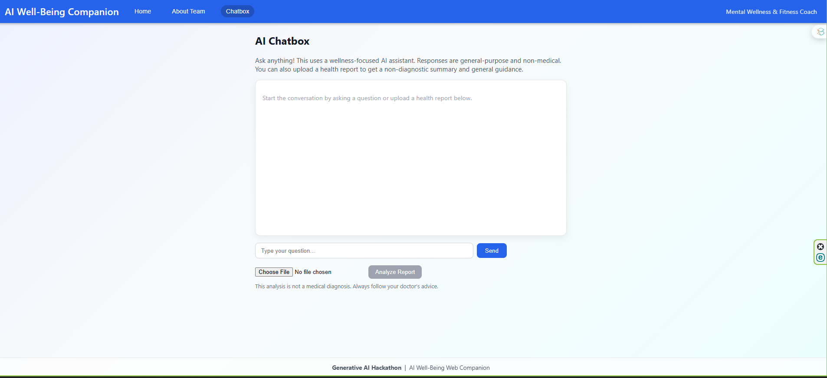
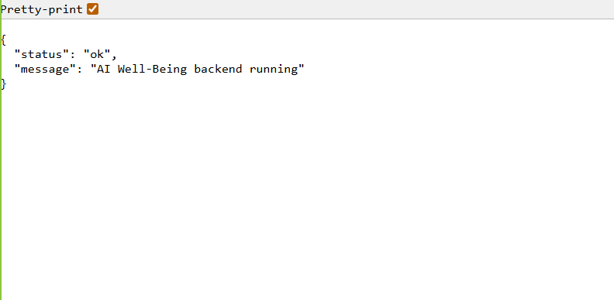
Screens

Slide 15
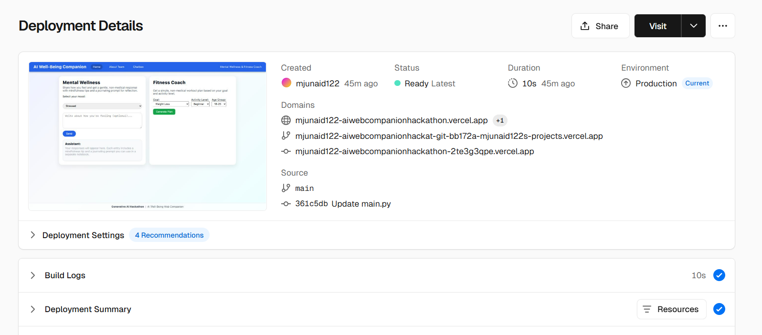
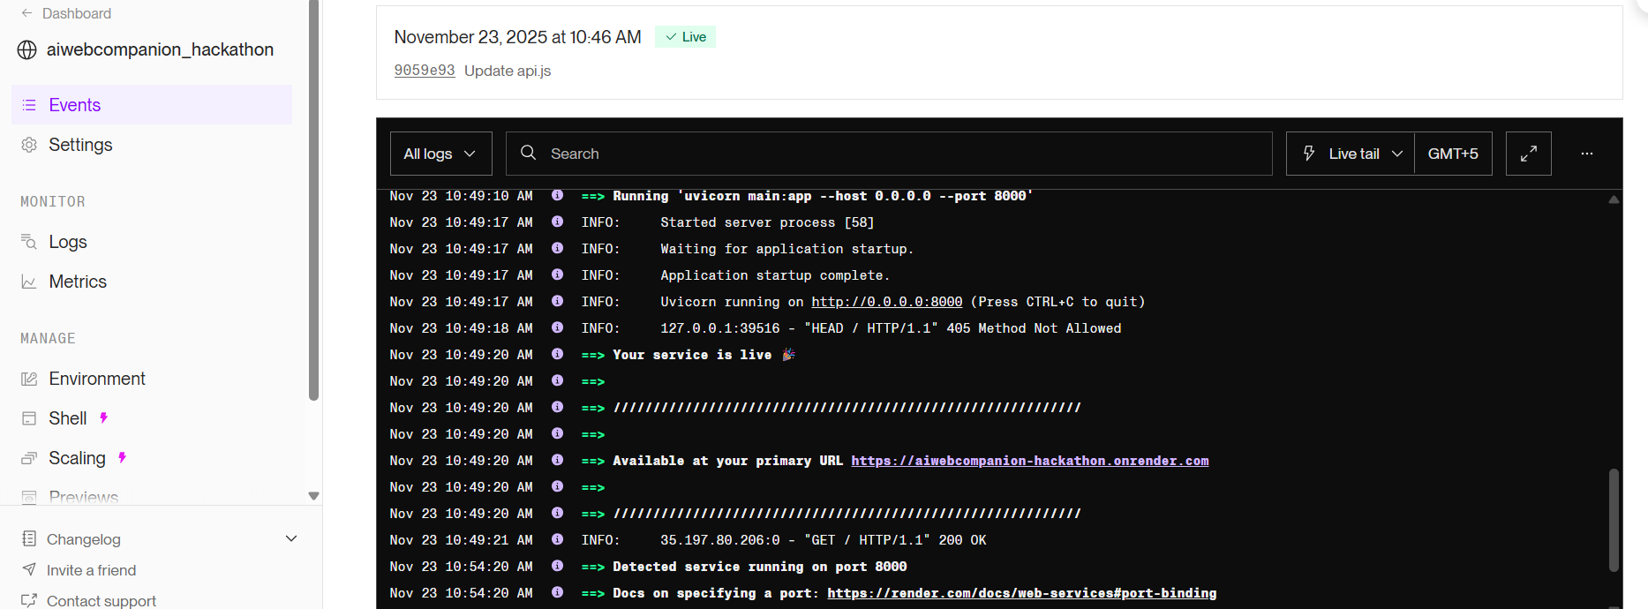
Deployment on Vercel and Render

Slide 16

Demo

Slide 17

Thank You

